Slide 1

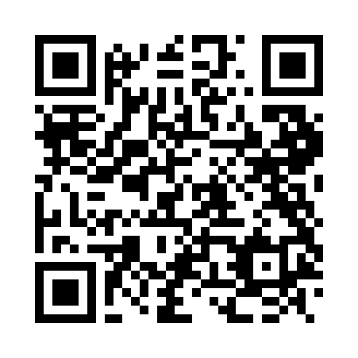
Event-Driven Architecture, Microservices and the Cloud
Shawn Wallace
shawn.wallace@centricconsulting.com
April 12, 2025

Slide 2
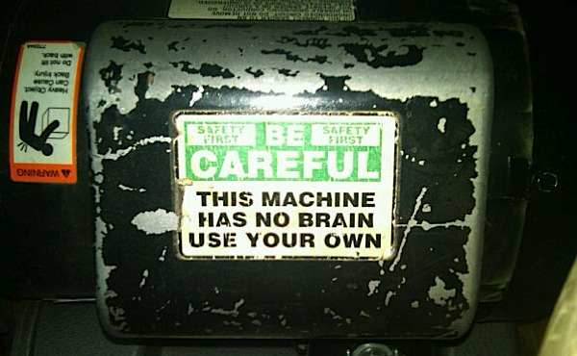
Notes:
These come from my experiences and research. You might have different opinions or I might just be wrong about some things.
How I came to go down this path.
looking for ways to orchestrate business processes in an enterprise without requiring specialized skillsets

Slide 3


A word about ‘productizing’ patterns & practices…
Notes:
https://www.gartner.com/en/information-technology/glossary/citizen-developer

Slide 4
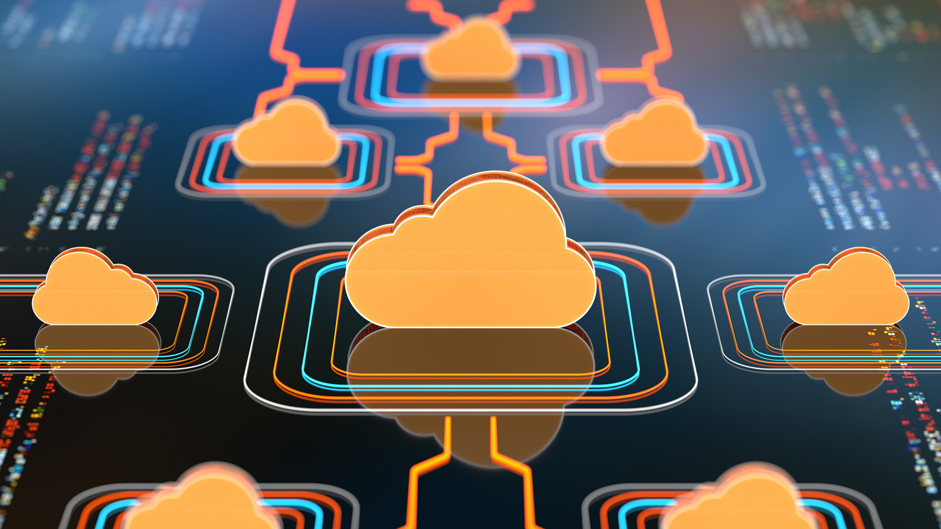
The Evolution of Architecture

Slide 5
Monolithic
Orders
Invoicing
Inventory
Logging
Warehouse
Profiles
Notes:
This is how a monolith is built
How agile killled this approach

Slide 6
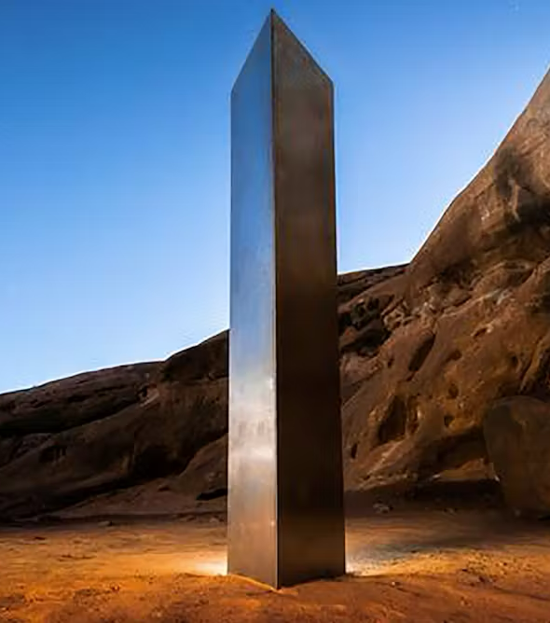
Why NOT a Monolith?
A product of our agile approach to our projects…smaller features finished earlier.
Our business users frequently need to move faster than we can support.
The goal is to deploy more often…this often is hard with monoliths.
One solution is to have smaller (and smaller) applications.
Notes:
While our features are smaller, the testing effort hasn’t changed.
We can rely some on test automation, but even these test suites can get inflated.
I’m not trying to enter the debate.

Slide 7
Monolithic
Orders
Invoicing
Inventory
Logging
Warehouse
Profiles
Notes:
This is how a monolith is built

Slide 8
Service Oriented Architectures (SOA)
Orders
Invoicing
Inventory
Logging
Profiles
Warehouse
Notes:
Here is what we have done…

Slide 9
SOA
Orders
Invoicing
Inventory
Logging
Profiles
Warehouse
Tightly Coupled
Notes:
How do you do system-wide logging?
Mention ESB bus (expensive, requires specialized skillsets, did I say expensive).
Discoverablitiity
Addressing
Hard to change/test/deploy
Direct Dependencies are a problem

Slide 10
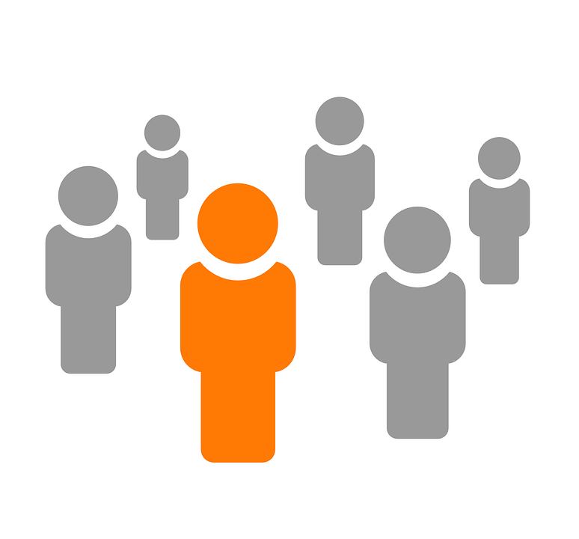
Service Oriented Architectures (SOA)
Orders
Invoicing
Inventory
Integration Team
Enterprise Service Bus
Logging
Profiles
Warehouse
STILL Tightly Coupled
Notes:
How do you do system-wide logging?
Mention ESB bus (expensive, requires specialized skillsets, did I say expensive).
Going in the right direction

Slide 11
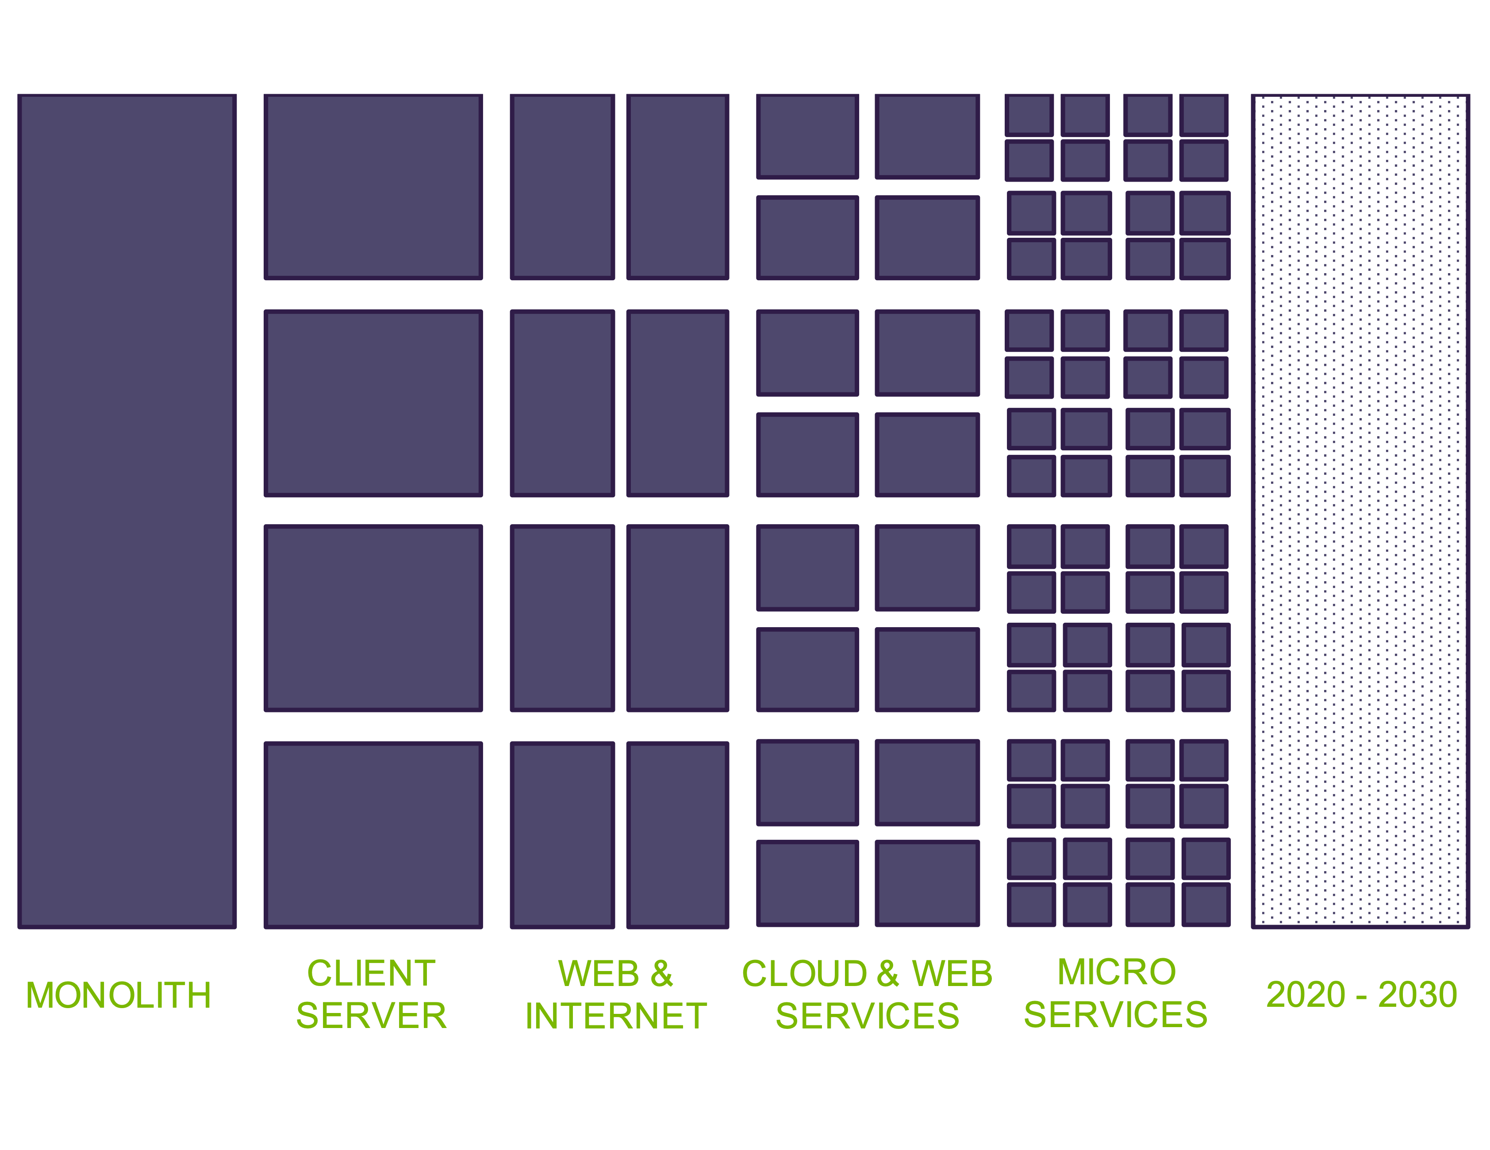

Notes:
You are probably somewhere on this continuum. Or maybe several places on it…
We are ALL cloud.

Slide 12

What is Event-Driven Architecture

Slide 13
What is Event-Driven Architecture? (EDA)
A design approach where systems react to events asynchronously, enabling loose coupling, scalability, reliability, and real-time responsiveness.
Events signal changes (state change) or actions (e.g. Order Placed)
Producers send events
Consumers respond to event via an event backbone (e.g. Kafka, Event Grid, RabbitMQ)
EDA helps systems evolve independently, making it ideal for microservices, IoT, and cloud-native applications.
Notes:
- Event producers, consumers, and backbone
- Events = facts/state changes
- Decoupled, scalable, real-time
_Notes: Define EDA clearly. Mention tools like Kafka, Event Grid, RabbitMQ. Emphasize benefits like loose coupling and scalability._

Slide 14
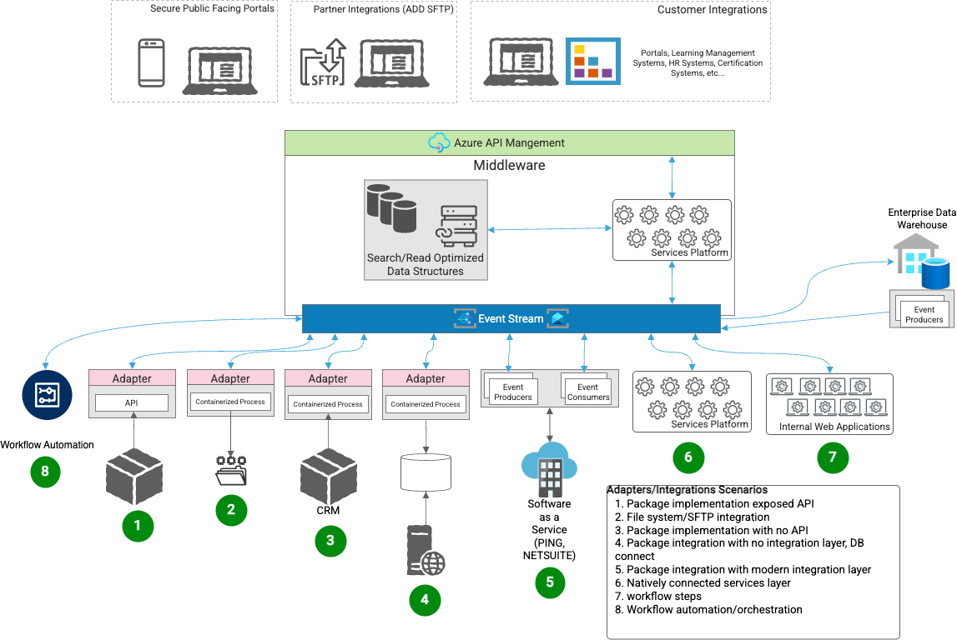
Idealized Architecture

Slide 15
Idealized Architecture
Features
Scalable
Resilient
Fault tolerant
Incremental Development
Loosely Coupled
More reliance on infrastructure
Defined/Governed Event Model
Flexible options for data ingestion and exchange

Slide 16
“Types” of Events
Domain – communicate a domain state change
Integration – notify of changed across domains/networks
System - telemetry
Temporal – scheduled
Platform – infrastructure health and status
Policy – telemetry events focused on governance
User/Actions – analytics
Data – mutations to data (change data capture)

Slide 17
“Types” of Events
Domain – communicate a domain state change
Integration – notify of changed across domains/networks
System - telemetry
Temporal – scheduled
Platform – infrastructure health and status
Policy – telemetry events focused on governance
User/Actions – analytics
Data – mutations to data (change data capture)

Slide 18
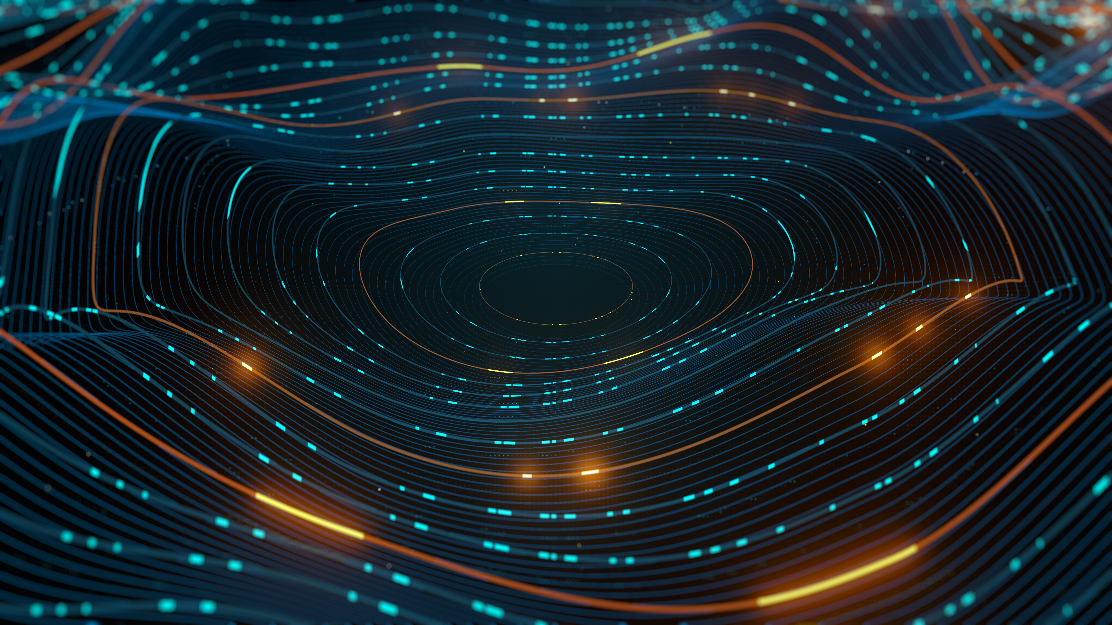
Design Patterns & Architectural Decisions

Slide 19
Idealized Architecture

Slide 20
API Gateway

Slide 21
Function as a Service
Client
Client
Client
Api Gateway
Function
Function
Function
Orchestration

Slide 22
Function as a Service
Client
Api Gateway
Function
Function
Function
Orchestration
Notes:
How should the applications functions talk to each other?

Slide 23
Function as a Service
Client
Api Gateway
Function
Function
Function
Event Stream

Slide 24
Event Stream

Slide 25

Loosely Coupled
Orders
Invoicing
Inventory
Event Stream
Logging
Profiles
Reporting

Slide 26
Easy to Integrate New Systems
Orders
Invoicing
Inventory
Event Stream
Logging
Profiles
Reporting
New System
Notes:
Add a new subsystem and start consuming events that are already in the system

Slide 27
Scales
Inventory
Inventory
Inventory
Orders
Invoicing
Inventory
Event Stream
Logging
Profiles
Reporting

Slide 28
Addresses “Data in Motion”
Orders
Invoicing
Inventory
Event Stream
Logging
Profiles
Reporting
Business Intelligence/Data & Analytics
Notes:
BI consumes events

Slide 29
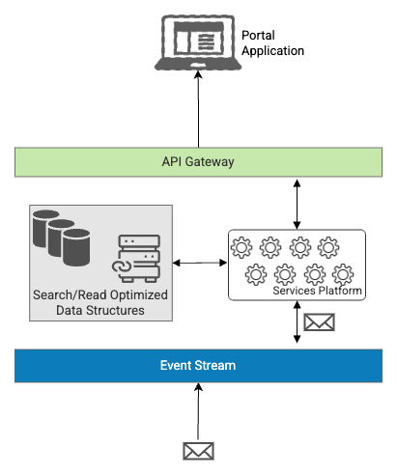
Eventual Consistency
Data in Motion
Denormalization for Fast Queries
Asynchronous Updates
Schema Design for Performance
Efficient Data Storage & Querying
Data Synchronization with Event Streams
Optimized Caching
Supports High/Dynamically Scaled Throughput

Slide 30
Idealized Architecture

Slide 31
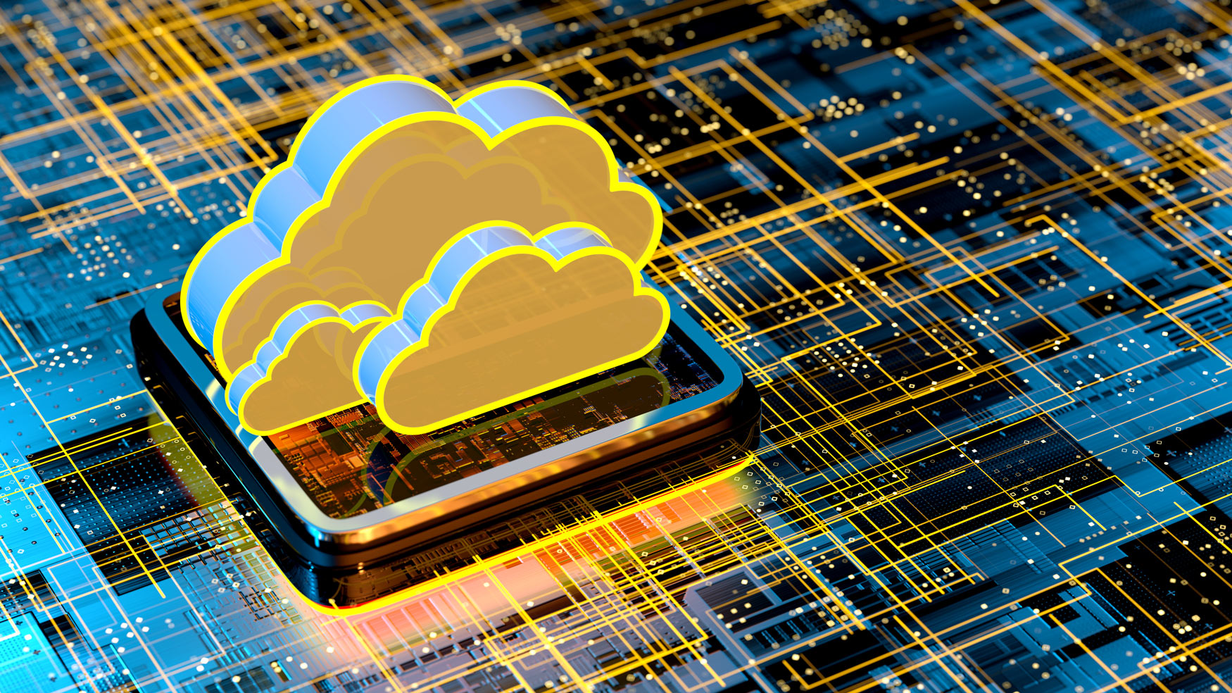
Sample Implementation

Slide 32
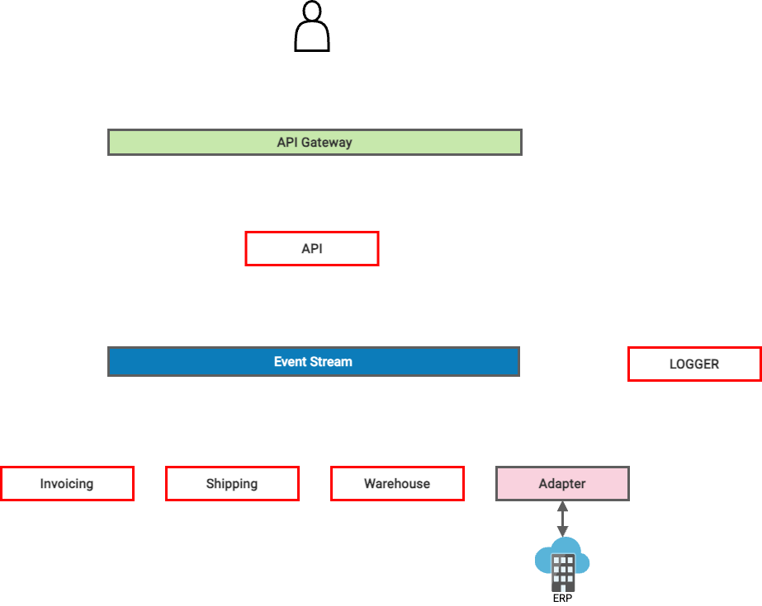

Order Create Event is generated by a Portal User

Slide 33
Customer Billed Event

Slide 34
Item Produced Event

Slide 35
Order Shipped Event

Slide 36
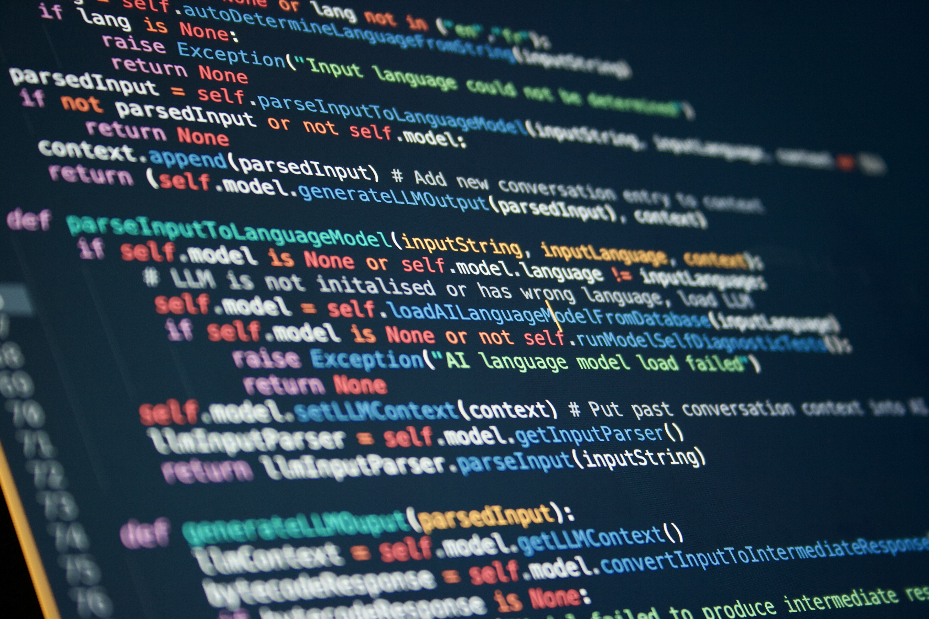
Before you begin…
1
Start Small, Implement Incrementally
2
Wrap/Adapt Legacy Systems rather than customize
3
Think in events, not endpoints (GOVERN, GOVERN, GOVERN)
Monitor and Log from Day 0
4
36

Slide 37
Thank you!
Shawn Wallace
shawn.wallace@centricconsulting.com
www.centricconsulting.com
https://blog.shawnewallace.com
37
Notes:
- The next steps section will be your wrap up and thank you slides. We are going to add a slide for you to be able to list what’s next before we move to the contact us slide, so that will be available when we distribute the deck to all of Centric.

Slide 38

Thank You
www.centricconsulting.com

